Slide 1
Software development Project
Using Django, Machine learning and Data Analysis
CSE 410
University of Asia Pacific Department of CSE
Course teacher : Fahad Ahmed
(Lecturer)

Slide 2
Group Members
1
2
3
Name : | Niamul Hasan
Id: | 17201026
Semester: | 4.1
Section : | A1
Name : | Tahura Nasrin
Id: | 17201031
Semester: | 4.1
Section : | A1
Name : | Md. Anik khan
Id: | 17201021
Semester: | 4.1
Section : | A1

Slide 3

GhorBariKenaBecha.com
ঘর_বাড়ি_কেনাবেচা.com

Slide 4
Problem definition
A Person is newly decided to buy an apartment in Dhaka city. And if the user have no idea about pricing. Not having a dedicated website for posting ADs about apartments and plot(Dhaka city).
Solution
Providing a price predicting system for new buyers.
Dedicated website for posting ADs about apartments and plot(Dhaka city).

Slide 5
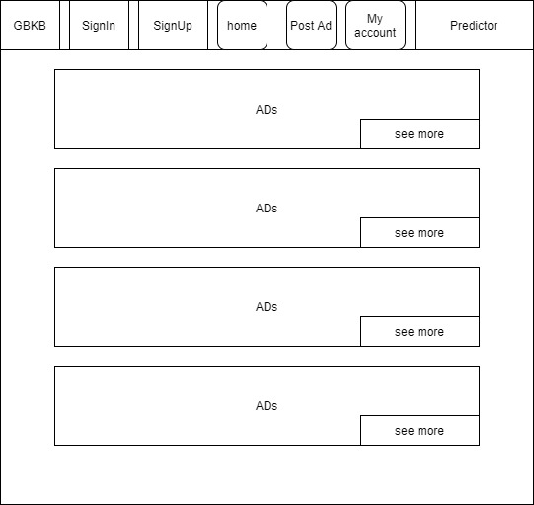
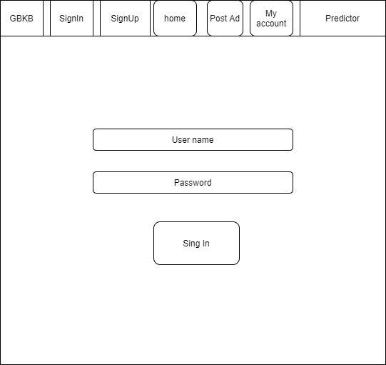
User Interface/solution
Home page
Sign In

Slide 6
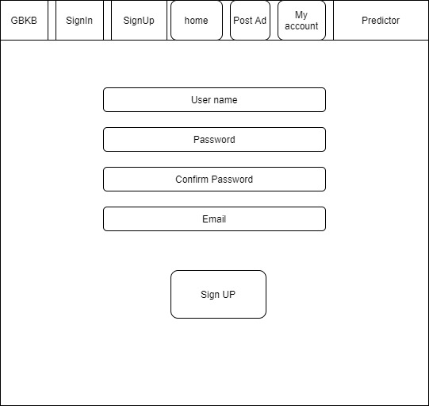
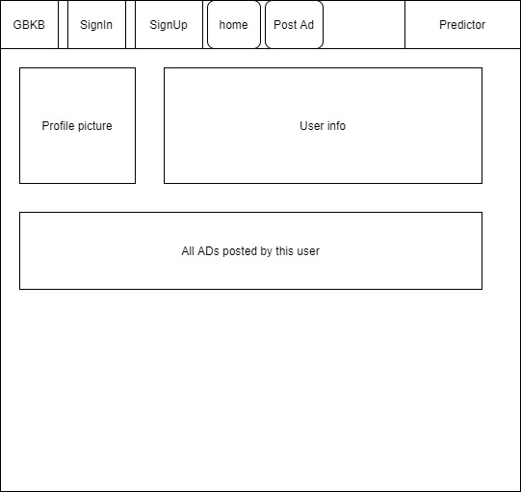
User Interface
Sign Up
My Account

Slide 7
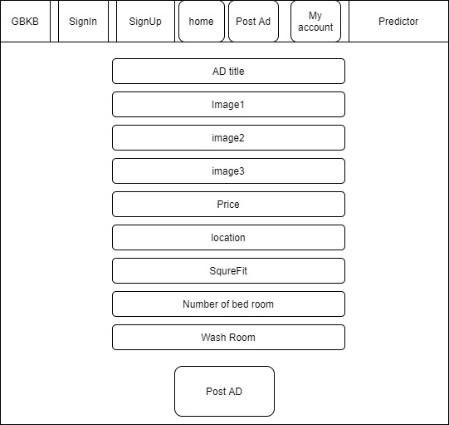
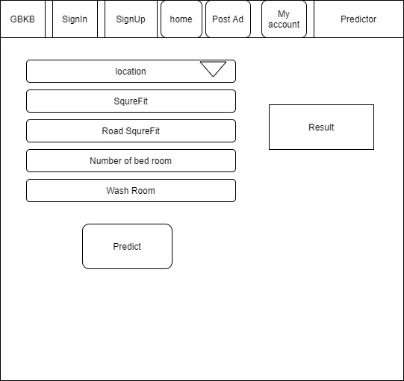
User Interface
Post Ad
Predictor

Slide 8
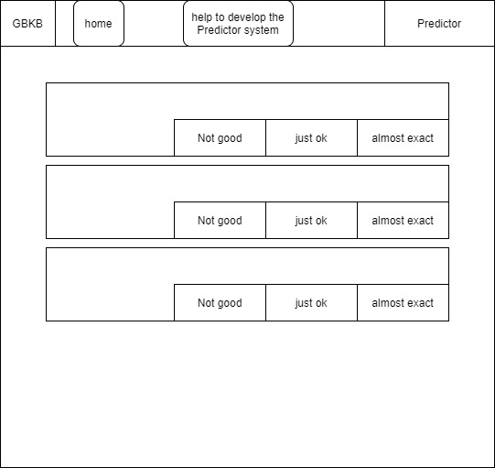
User Interface
Request user to help us, to develop our prediction system

Slide 9
Prediction system
Machine learning: Multiple linear regression Data Analysis: Methods

Slide 10
Impact
Impact on Society and environment

Slide 11
Range of Complex Engineering Problem Solving
Attribute | Matching
P1: Depth of knowledge required | Here we using depth knowledge of Html5, css3, python3, Django, Machine Learning and Data Analysis
P2: Range of Conflicting Requirements | For this project, requirements is to set a machine learning model to predict the apartment price in Dhaka city. But, there is no such data set for that. There are some data sets for New York city and other big cities. So, to build this we need to analyze the existing data and try to collect data accordingly for the model. At first we thinking to add 4 parameter to data set. But later we found that we should include more parameters.
P3: Depth of Analysis Required | There are some forms of machine learning model, with the depth of knowledge and by analyzing we have to select one of these models. So, having no obvious solution and require abstract thinking and originality in analysis to formulate suitable models.
P4: Familiarity of issues | Involve infrequently encountered issues. Like, to train machine learning we need a data set. But here we found some issues, that no such exact data exist. So, we have to collect. And for that we are infrequently encountering issues.
P7: Interdependence | High level problems including many component parts or sub-problems. Here the e-commerce is an independent module or part of the project. And The predicting system is another module or part of the project.

Slide 12
Thank You
Any question?

